Slide 1
IoT Technology Based Vehicle Pollution Monitoring and Control
Project Team Members
S. Gomu Aravind (Reg.No. : 201802031)
K. Haresh (Reg.No. : 201802033)
S. Praveen (Reg.No. : 201802073)
Under the guidance of
Prof. M.Jawahar, M.E., (Ph.D.,)
Assistant Professor
Department of Electrical and Electronics Engineering
Mepco Schlenk Engineering College (Autonomous)
Sivakasi

Slide 2
Outline
Objectives
Scope
Literature Review
Summary of Literature Review
Project Proposal – Block Diagram
Project Proposal – Summary
Beneficiaries
Gantt Chart
Specification Requirements
Flow Chart
Purpose of MQ-135 & nRF24L01
Communication between transmitter and receiver
Flow chart of Transmission
Flow chart of Receiving
GSM Module-sim800l
Why GSM sim800l?
Results and Tabulation
Project Status
References

Slide 3
Objectives
To help transport officials to penalize the vehicle emitting more amount of carbon-monoxide.
To indicate the vehicle owner to take steps to control the emission of carbon-monoxide by the vehicle.

Slide 4
Scope
Monitoring the pollution emitted by vehicles helps in describing the condition of automobiles.
Controlling helps in alerting the vehicle user to create a maintenance check.
Strict measures could be taken in ignoring the messages by creating a fine.

Slide 5
Literature Review
Sl.No. | Publication | Index
1 | S. Muthukumar , W. Sherine Mary, S. Jayanthi, R. Kiruthiga, M. Mahalakshmi, “IoT based Air Pollution Monitoring and Control System”, Proceedings of the International Conference on Inventive Research in Computing Applications, 2018. | -
Description : The proposed system measures the air quality of a particular area with the help of the hardware module fixed at certain locations like lamp posts. The sensed values are sent to a mobile application which makes the automobile users to take route which is less polluted.
Description :

Slide 6
Literature Review(Contd..)
Sl.No. | Publication | Index
2 | Aayushi Gautam, Gaurav Verma, Shamimul Qamar, Sushant Shekhar “Vehicle Pollution Monitoring, Control and Challan System Using MQ2 Sensor Based on Internet of Things” Springer Science+Business Media, LLC, part of Springer Nature 2019 | -
Description : This paper describes about a prototype which uses a raspberry pi for monitoring and control. Here the vehicle user will be warned by buzzer and if it is ignored a challan is filed against the user and it is sent to his mail id.
Description :

Slide 7
Literature Review(Contd..)
Sl.No. | Publication | Index
3 | Pramodh Narayan L, Shankha Mukhopadhyay, Utkarsh Kumar, Pratyush Prasanna Sahu and D Vishnu Simha “Vehicular Pollution Monitoring Using IoT” IJARIIE-ISSN(O), Vol No-4 Issue No-5 2018 | -
Description : This project describes the sending of sensed values to the cloud, which can be analyzed and interpreted . This sensing and sending the data is done with the help of a Wi-Fi module addition to the alert message displayed in the LCD.
Description :

Slide 8
Summary of Literature Review
Several ways are available to measure the amount of pollutants released by vehicles.
The sensed data could be sent to the cloud only using a Wi-Fi module.
A challan is filed against the vehicle user which is sent through mail id.
An alert message is triggered or notified using a mobile application.

Slide 9
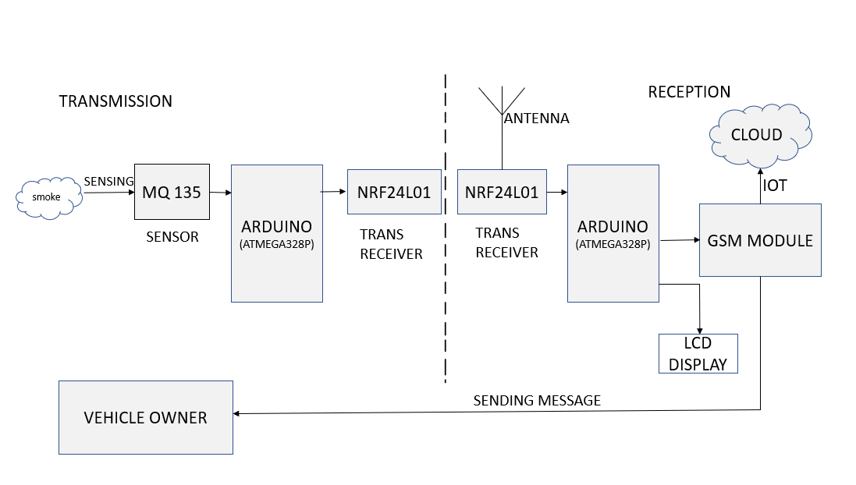
Project Proposal – Block Diagram

Slide 10
Beneficiaries
It will reduce the air pollution in the atmosphere caused by the vehicles.
Death due to air borne diseases will be less.
Poor air quality has harmful effects on human health will be reduced.
Pollutants emitted by vehicles causing damage to plants and buildings will be control.

Slide 11
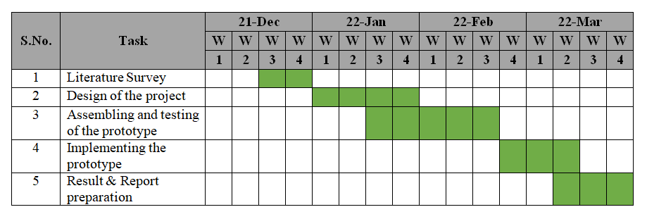
Gantt Chart

Slide 12
Specification Requirements
S. No | Component Name | Rating | Quantity
1 | MQ-135 Sensor | 150mA | 1
2 | Arduino UNO | 20mA-40mA | 2
3 | nRF24L01 | 2.4 GHz ISM Band | 2
4 | GSM Module | 3.4-4.4V | 1
5 | LCD Display | 200mA | 1

Slide 13
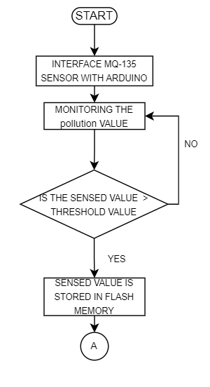
Flow Chart

Slide 14
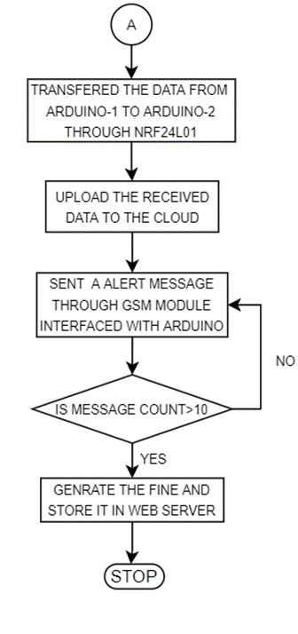
Flow Chart(Contd..)

Slide 15
Purpose of MQ-135 & nRF24L01
The MQ-135 sensor is used to sense the various types of gas. In this project we use to sense the CO gas.
The nRF24L01 is a single chip 2.4GHz trans-receiver suitable for low power wireless applications. It is designed for operation in worldwide ISM frequency band at 2.4 – 2.48 GHz
It is designed to use in various aspects such as radio, transmitter, receiver, power management and host interface.

Slide 16
Communication between Transmitter and Receiver
The NRF24L01+ runs at the worldwide 2.4 – 2.5 GHz ISM band using GFSK modulation.
It has 250 kbps – 2Mbps baud rates, and with a lower baud rate, it can reach up to 100m.
GFSK stands for Gaussian Frequency Shift Keying modulation.
In GFSK, baseband pulses (consists of -1 and 1) are first passed through the gaussian filter before modulation.
This makes pulses smooth and hence limit the modulated spectrum width. This process is known as pulse shaping.

Slide 17
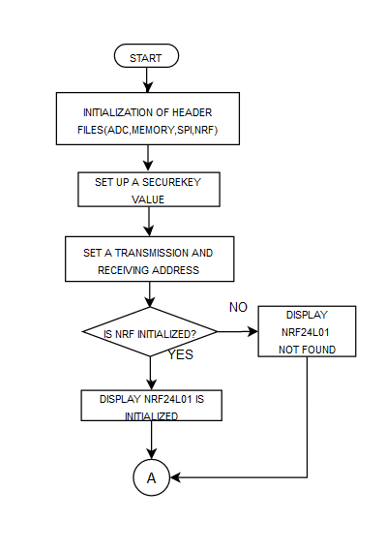
Flow Chart for Transmission

Slide 18
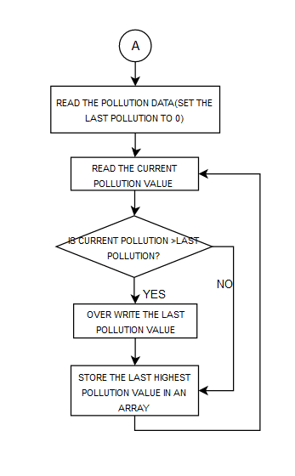
Flow Chart for Transmission(Contd..)

Slide 19
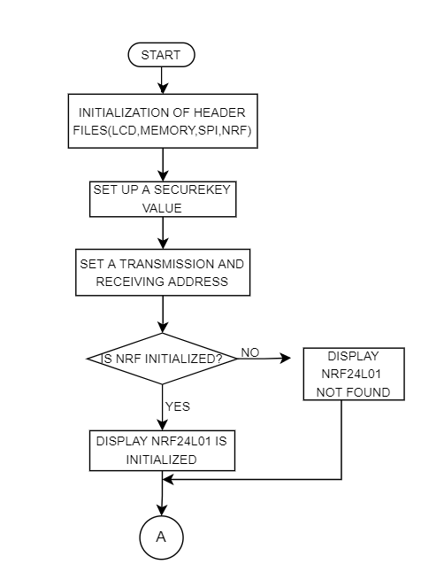
Flow Chart for Reception

Slide 20
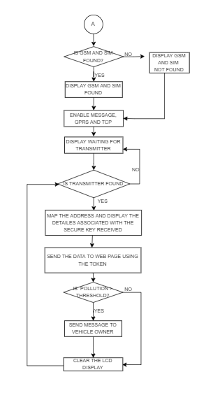
Flow Chart for Reception(Contd..)

Slide 21
GSM Module-SIM800l
SIM800L GSM/GPRS module is a miniature GSM modem, which can be integrated into a great number of IoT projects
There is an LED on the top right side of the SIM800L Cellular Module which indicates the status of your cellular network.
It can be used for various purposes
* Connect onto any global GSM network with any 2G SIM
* Send and receive SMS messages
* Send and receive GPRS data (TCP/IP, HTTP, etc.)

Slide 22
Why GSM sim800l ?
Generally we use ESP8266 or ESP32 or any other Wi-Fi Modules to send any sensor data to the Internet wirelessly.
But the disadvantage of using Wi-Fi is, it is not available everywhere. The Wi-Fi signal is limited to certain locations and to a certain range up to a few meters.
So, GSM GPRS is the only alternative left as per the present scenario and current technology. GSM GPRS Module allows you to add location-tracking, voice, text, SMS, and data to your application.
The big advantage of GSM/GPRS Connectivity is, it covers a wide area and signal/connectivity is available almost everywhere.

Slide 23
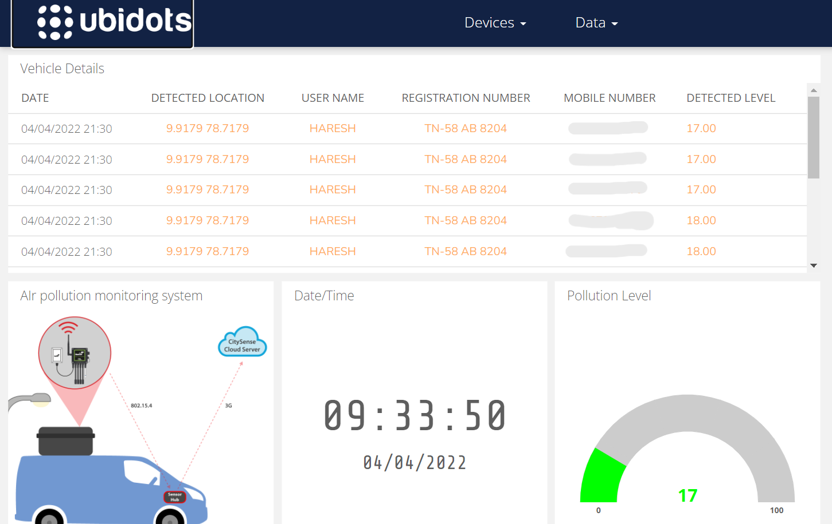
Results and Tabulation

Slide 24
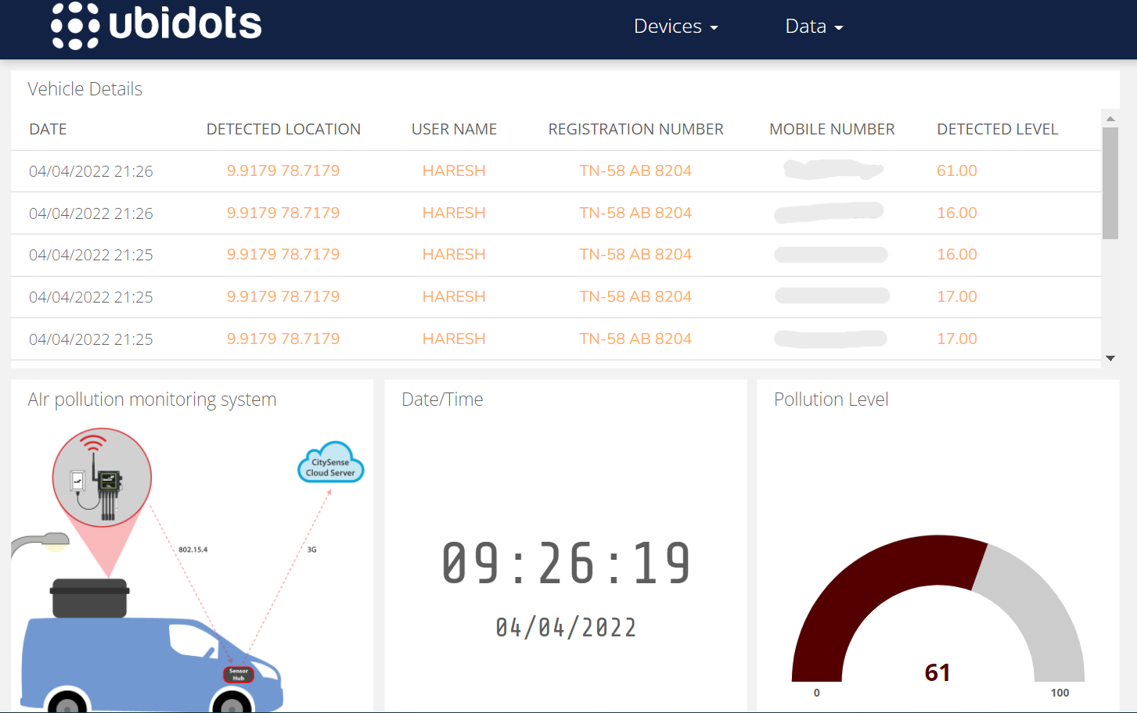
Results and Tabulation(Contd ..)

Slide 25
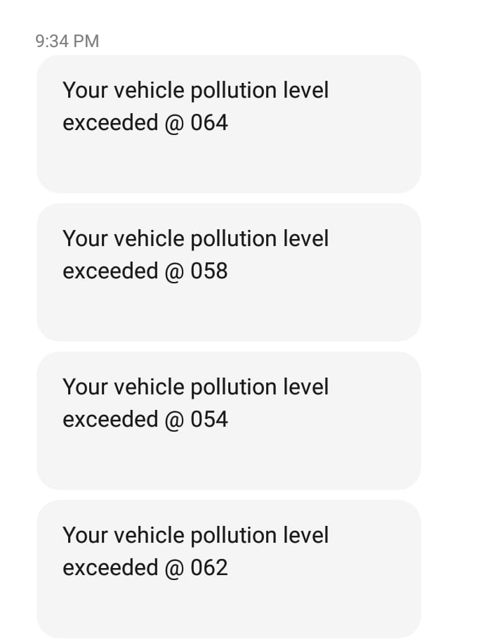
Results and Tabulation(Contd ..)

Slide 26
Results and Tabulation(Contd ..)
S.No | Name of the Vehicle Owner | Pollution Level
1 | Raju | 50
2 | Joel | 55
3 | Vishnu | 51
4 | Naveen | 60

Slide 27
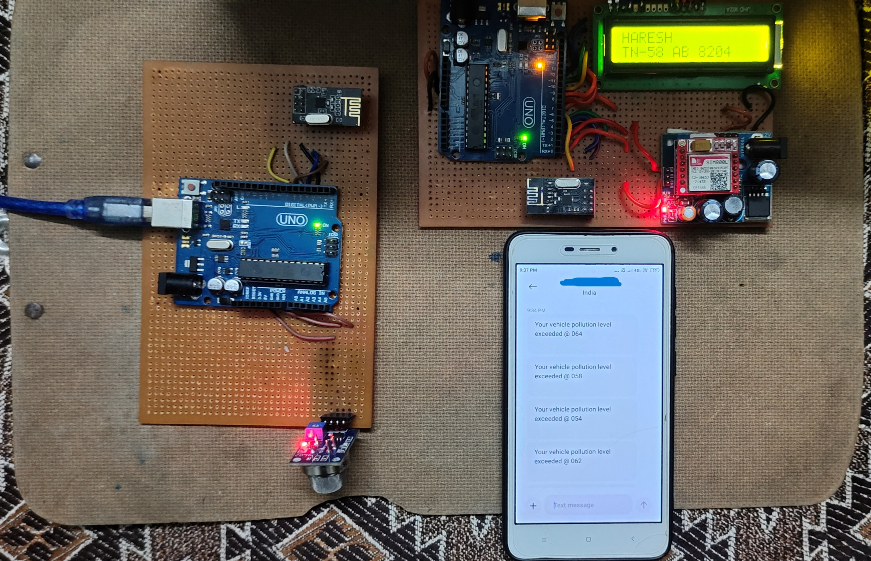
Project Status

Slide 28
References
S. Muthukumar , W. Sherine Mary, S. Jayanthi, R. Kiruthiga, M. Mahalakshmi, “IoT based Air Pollution Monitoring and Control System”, Proceedings of the International Conference on Inventive Research in Computing Applications, 2018.
Aayushi Gautam, Gaurav Verma, Shamimul Qamar, Sushant Shekhar “Vehicle Pollution Monitoring, Control and Challan System Using MQ2 Sensor Based on Internet of Things” Springer Science+Business Media, LLC, part of Springer Nature 2019.
Pramodh Narayan L, Shankha Mukhopadhyay, Utkarsh Kumar, Pratyush Prasanna Sahu and D Vishnu Simha “Vehicular Pollution Monitoring Using IoT” IJARIIE-ISSN(O), Vol-4 Issue-5 2018.
Abdullah Kadrl, Elias Yaacoub, Mohammed Mushtaha, Adnan Abu Dayya, “Air Quality Monitoring and Analysis in Qatar using a Wireless Sensor Network Deployment”, Qatar Mobility Innovations Centre (QMIC), Qatar Science and Technology Park, Doha, Qatar, 2020.
P. Srividya, L. Nirmala Devi “An IoT Based Vehicular Pollution Monitoring System for Automobile”, CIIS’19, November, 2019.

Slide 29
References (Contd..)
Khaled Bashir Shaban, Abdullah Kadri and Eman Rezk “Urban Air Pollution Monitoring System With Forecasting Models”, IEEE SENSORS JOURNAL, Vol. 16, No. 8, Apr 15, 2016.
Joseph Mathew Skaria Maliyekal, Shancy Elizabeth Shaji, Vandana H, Divya R S “Vehicular Pollution Monitoring System Using IoT” Journal of Communication Engineering and Its Innovations Volume 5 Issue 3 ,2019.
Jyoti Sharma, Siby John “Real Time Ambient Air Quality Monitoring System Using Sensor Technology” International Journal of Advances in Mechanical and Civil Engineering Volume-4, Issue-1, Feb.-2017.
A. R. Al-Ali,Imran Zualkernan, and Fadi Aloul “A Mobile GPRS-Sensors Array for Air Pollution Monitoring” IEEE SENSORS JOURNAL, Vol. 10, No. 10, Oct 2010.
Hugo Nugra, Alejandra Abad, Walter Fuertes, Fernando Galárraga, Hernán Aules, César Villacís, and Theofilos Toulkeridis “A Low-cost IoT Application for the Urban Traffic of Vehicles, based on Wireless Sensors using GSM Technology” International Symposium on Distributed Simulation and Real Time Applications, 2016.

